Slide 1
CTEIS Expenditures
Presented by
PTD Technology
3001 Coolidge Road
Suite 403
East Lansing, MI 48823

Slide 2
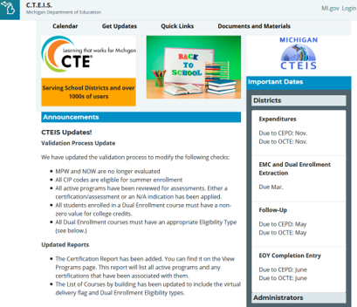
CTEIS Updates
Join the CTEIS Listserv for continual updates: e-mail martinezj9@michigan.gov
Function and object codes are updated by OCTE and published in Excel workbooks on the CTEIS Knowledge Base at: support.cteis.com/Data-Entry/Expenditures
Remember to enter expenditures into their appropriate funding source fields.
Entering all expenditures into the 61a(1) box risks a submission in which your entries exceed the total 61a(1) funds you received, which OCTE does not allow.

Slide 3
Support
Technical Help
I pushed a button and nothing happened!
Why am I getting this error message?
PTD Help Desk
cteis.help@PTDtechnology.com
(800) 203-0614 or (517) 333-9363
Ext. 128
Policy Help
Where do I find my info?
How do I report a credit?
Joan Church
ChurchJ@michigan.gov
(517) 335-0360
OCTE Website: http://www.michigan.gov/octe

Slide 4
Logging In
Make sure you have a MEIS account:
https://mdoe.state.mi.us/meis.
Your Fiscal Agency Authorized Official (Level 5 Official) will authorize your MEIS account for CTEIS.
Navigate to www.cteis.com (or train.cteis.com).
Enter your MEIS account username and password.
Make sure your Level 5 Official has given you access to the Data Entry menu and the Expenditures module.

Slide 5
What Is the Expenditures Report?
Used to collect funds spent in support of state-approved CTE programs.
Section 61a(1), 61b, 61c CTE Added Cost funds spent.
Other funds spent – generally local funds; excludes Perkins funding.
Why Is This Report Important?
Captures the true cost of CTE programming.
Data is used annually to calculate Added Cost Factors for each CIP Code.

Slide 6
OCTE Expenditures Guidance Workbooks
Located on the CTEIS Knowledge Base: support.cteis.com/Data-Entry/Expenditures
Allowable expenditures.
Function/object code categories and descriptions.
Program improvement items.

Slide 7
The 5-Step Process
Collect expenditure information from appropriate personnel.
Create distribution tables (optional).
Enter expenditure records.
Run expenditures validation.
Submit your final Expenditures Report.

Slide 8
What Information Do I Report?
State-approved CTE programs (Grades 9-12).
How do I know they are approved?
The classes contained enrolled students.
The enrollments were reported on the Spring Enrollment Report.
The programs appear within your Expenditures grid.
Expenditures are reported for individual programs within each of your buildings.

Slide 9
Collecting Expenditure Information
Typically collected from the Business / Finance Office.
Contact tables may be helpful!
Example in manual (Appendix: Contact Table).
Know the Following:
Amount of expenditure you are reporting.
PSN for each expenditure.
Percentage of expenditure to be applied to each PSN (if applied to multiple programs).

Slide 10
Generating a Blank Worksheet
*Tip: To compile worksheets that include each PSN on your report, export your raw data and set up a workbook in Excel.
Click Data Entry  Expenditures  Expenditure Entry.
Select your district and building.
Click Export to Excel, then save your worksheet.

Slide 11
Distribution Tables
Allow you to spread the cost of an expenditure across multiple PSNs.
Examples:
Distributing a single teacher’s salary across multiple programs.
“Bundling” travel time to apply to many PSNs.
Claiming maintenance costs for several classrooms.
Distribution Table: “Travel”
PSN | Amount to Report
07703 | 25%
14038 | 25%
17755 | 50%
Click Data Entry  Expenditures  Distribution Tables.
Select your district and building.
Click check boxes to include programs, then name and save the table.
CTEIS will divide expenditure entries in the table across the PSNs included, weighted based on your chosen settings.

Slide 12
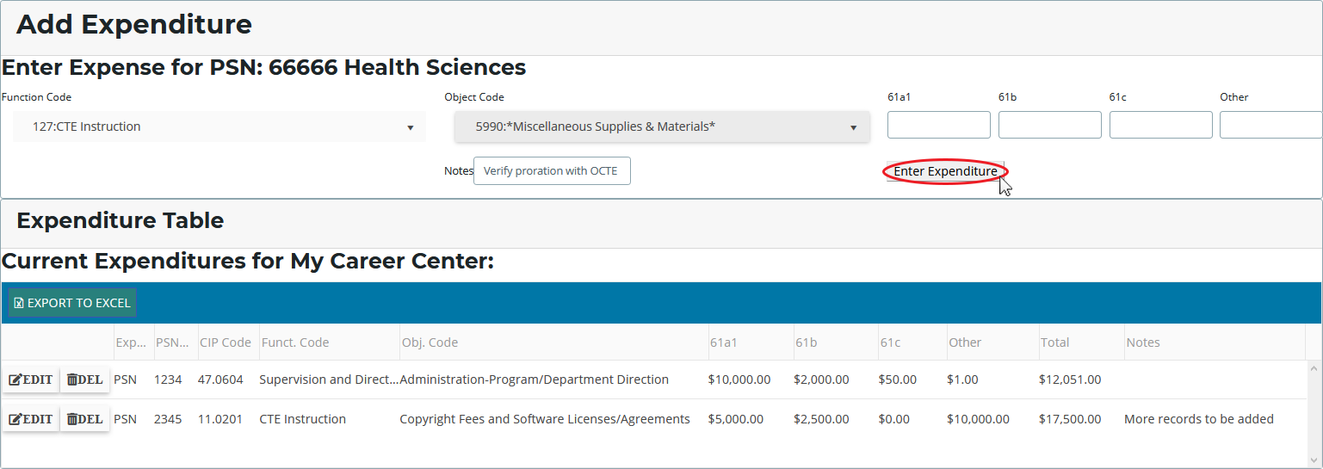
Entering Expenditure Records
Click Data Entry  Expenditures  Expenditure Entry.
Select your district and building.
Click a [$] button to enter program expenditures.
Select a function and object code, then enter the dollars that were applied to the program from each of the four funding sources.

Slide 13
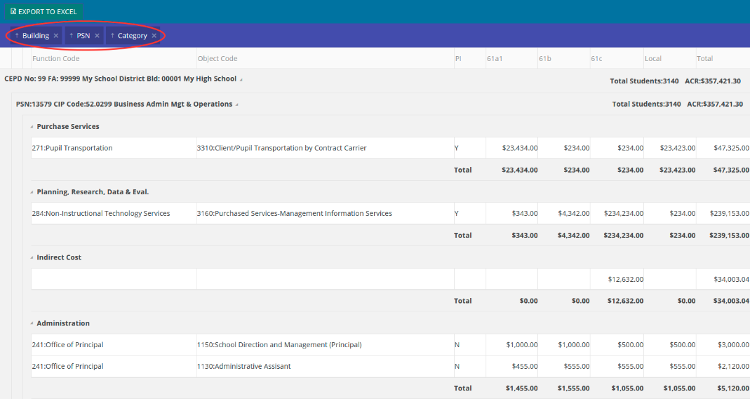
Run Expenditure Validation
Click Data Entry  Expenditures  Expenditure Review.
Select your district.
Click a [VALIDATE] button to review expenditure entries.
Filter your view by:
Removing labels from the header (Building, PSN, Category).
Dragging additional labels to the header row.

Slide 14
Completing Your Report
After all errors are cleared:
The Complete button becomes active.
When a building is marked complete, the system attempts to E-mail your Fiscal Agency Authorized Official.
Follow up by contacting your FA personally.
Export your report to an Excel file.

Slide 15
Submitting Your Report
Reports submitted at the building level are subject to a series of reviews:
Building Level → Fiscal Agent →
CEPD Administrator → OCTE
Directions for Fiscal Agent and CEPD Administrator submissions are on the CTEIS Knowledge Base:
support.cteis.com/Data-Entry/Expenditures

Slide 16
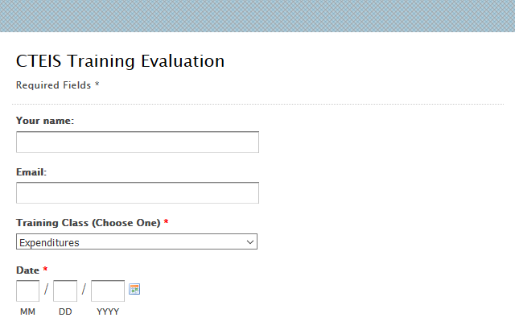
Questions?
Thank you!
Don’t forget to fill out our Training Evaluation Form at
support.cteis.com/Training/ Registration-General-Info

