Slide 1
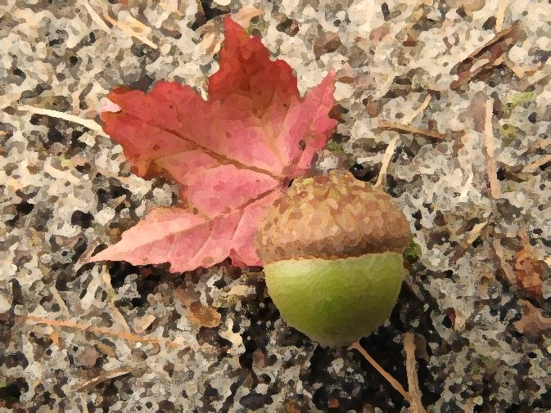
Fall Data Entry for the Spring Enrollment Report
Presented by
PTD Technology
3001 Coolidge Road Suite 403
East Lansing, MI 48823

Slide 2
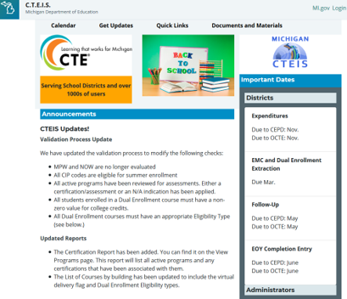
CTEIS Updates
Join the CTEIS Listserv for continual updates: e-mail MartinezJ9@michigan.gov
Fall Data Entry: building reporters must enter courses and instructors into CTEIS by October 30, 2020.
The New Programs Application is moving to the Grant Electronic Management System (GEMS).
The due date is still TBD.
New Work-Based Learning guides and training schedules will be published in the near future.

Slide 3
Fall Reminders!
Student enrollment definitions:
Participant: 4 segments
Concentrator: 8 segments
Completer: 12 segments
Dual Enrollment and E/MC students must be enrolled and have correct UICs by March 12th.
All students must be enrolled in CTEIS course sections by May 14th – enter enrollment data as it becomes available.

Slide 4
What Is CTE Enrollment and Completion Collection?
The annual report required by OCTE that verifies your student, teacher, and class enrollment data.
Important uses of your data:
Determines next year’s funding allocations.
Allows the state adhere to federal reporting requirements.
Updates student exit and completer status – segment verification is extremely important!

Slide 5
Support
Technical Help
I pushed a button and nothing happened!
Why am I getting this error message?
PTD Help Desk
cteis.help@PTDtechnology.com
(800) 203-0614 or (517) 333-9363
Ext. 128
Policy Help
Where do I find my info?
How do I report a credit?
Joan Church
ChurchJ@michigan.gov
(517) 335-0360
OCTE Website: http://www.michigan.gov/octe

Slide 6
What Is The Report Process?
Several types of data need to be entered into CTEIS:
Course data (using a provided instructional design form).
Verify class details, instructors, and segments.
Student data.
Enrollment data.
Grades.
After entering your information:
Verify and correct data as required.
Review student segment profiles to ensure your students can become completers.

Slide 7
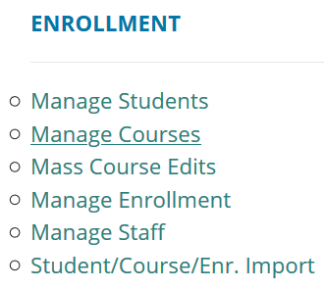
Manage Courses
Use an instructional design form when entering courses.
Building reporters are never responsible for determining class details or segment information.
Look for the Data Entry link.
Click on Manage Courses.
Here you may:
Add a new course section
Edit individual course sections
Copy course information

Slide 8
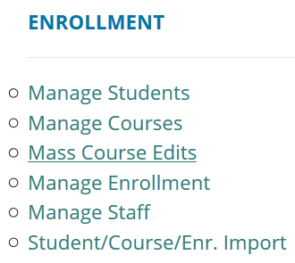
Mass Course Edits
Mass Course Edits allow you to update multiple records simultaneously.
Go to Data Entry, then Mass Course Edits.
The fields you may mass edit include:
Beginning and ending dates
Semester
Virtual delivery mode
High school credits earned
College credits earned
You may also Mass Deactivate courses using this feature.

Slide 9
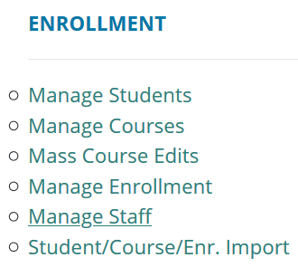
Manage Staff
The Manage Courses screen also allows you to input staff members and link them to your courses.
Use the Course Section Staff List panel at the bottom of the screen.
Go to Data Entry, then Manage Staff.
Here you may:
View staff records.
Add new staff records.
Edit pre-existing staff records.

Slide 10
Manage Students
It is extremely important that this information is entered correctly as it is used to:
Update MSDS supplemental data.
Allow Follow-Up reporters to contact students.
Go to Data Entry, then Manage Students.
From this screen, you may:
Add new student records
Edit / Review pre-existing student records
View student enrollment history and segment profiles

Slide 11
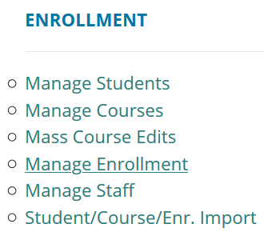
Manage Enrollment
CTEIS offers a variety of tools to help you manage your student enrollments.
Go to Data Entry, then Manage Enrollment.
Here you may take a variety of actions:
Enroll students in courses
Edit student enrollment information
Copy / transfer enrolled students from one class to another
Print a class list
Input student grades
Check the segments students are enrolled in

Slide 12
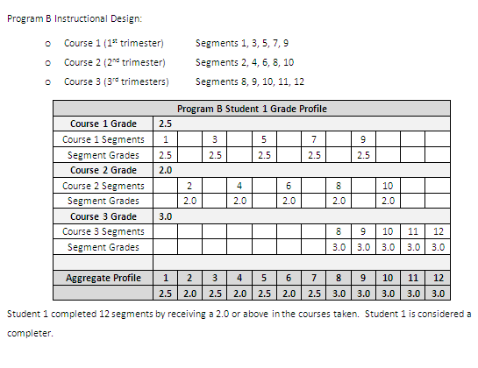
Segment Profiles
Courses deliver sets of segments to students.
Students receive a course grade.
If the course grade is a 2.0 or higher, the student receives credit for each segment within the course.
If multiple courses offer the same segment, the highest grade determines whether the segment is included or not.

Slide 13
Enter Grades
If your school uses a grade point system rather than letter codes, use the conversion chart within the instructional guide.
Go to Data Entry, then Manage Students.
Locate and select the student you wish to enter grades for.
Locate the “Current Enrollment” panel.
Select a grade from the drop-down menu.
OR
Go to Data Entry, then Manage Enrollment.
Select the course and student you wish to enter grades for.
Click “Edit;” enter a grade within the “LetterGrade” column and click “Update.”

Slide 14
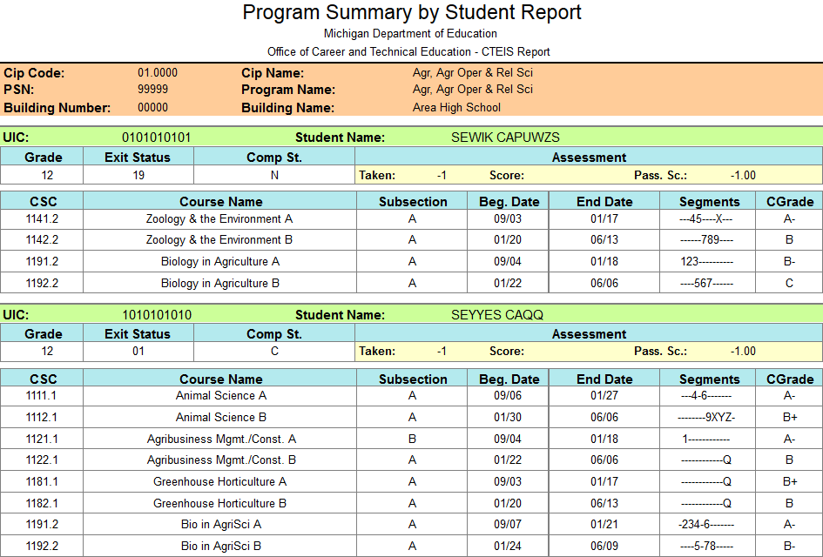
Review Building Reports
Program Enrollment History Report
Displays the historical information of all students enrolled within a selected program.
Includes segment profiles and assessment scores.
Go to Reports ➔ Building Reports ➔ Program/Student Reports.
Use these reports to verify that:
Your students have been enrolled into the correct courses for the current year.
Your courses offer the 12 segments required for your students to become completers.

Slide 15
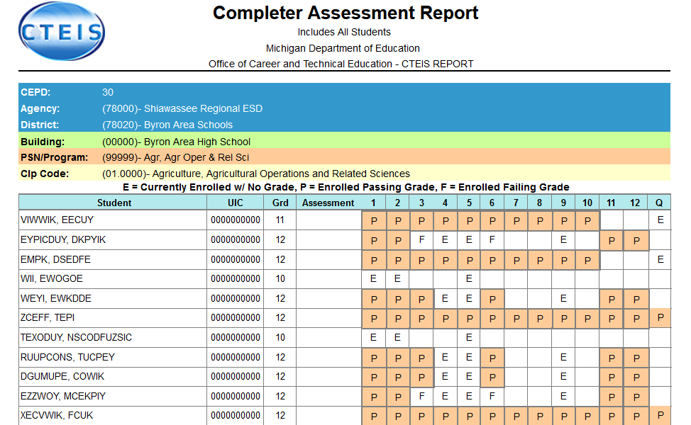
Validate Enrollment Data
Run validation early and frequently to alert yourself to student data issues that may take time to resolve, and to also gain access to helpful reports.
Go to Data Entry ➔ Enrollment Completion.
Indicate the year you wish to run the validation for.
Click the Validate link to the left of the building name.
Review all warnings.
Correct all errors.
Print your summary enrollment reports.

Slide 16
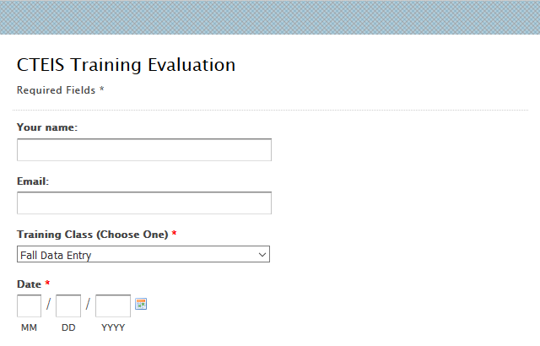
Questions?
Thank you!
Don’t forget to fill out our Training Evaluation Form at
support.cteis.com

