Slide 1
CTEIS Expenditures
Presented by
PTD Technology
3001 Coolidge Road
Suite 403
East Lansing, MI 48823

Slide 2
Expenditures

Slide 3
Report All Expenditures
Meet requirement to expend funds
61a1 and 61b
Required Expenditures (75% of added cost of program)
Program Improvement Requirement
Program Cost Determination
Feeds back into funding formula

Slide 4
Support
Technical Help
I pushed a button, and nothing happened!
Why am I getting this error message?
PTD Help Desk
cteis.help@PTDtechnology.com
(800) 203-0614 or (517) 333-9363
Ext. 128
Policy Help
Where do I find my info?
How do I report a credit?
Joan Church
ChurchJ@michigan.gov
(517) 335-0360
OCTE Website: http://www.michigan.gov/octe

Slide 5
OCTE Expenditures Guidance Workbooks
Located on the CTEIS Knowledge Base: support.cteis.com/Data-Entry/Expenditures
Allowable expenditures.
Function/object code categories and descriptions.
Program improvement items.

Slide 6
Logging In
Make sure you have a MEIS account:
https://mdoe.state.mi.us/meis.
Your Fiscal Agency Authorized Official (Level 5 Official) will authorize your MEIS account for CTEIS.
Navigate to www.cteis.com (or train.cteis.com).
Enter your MEIS account username and password.
Make sure your Level 5 Official has given you access to the Data Entry menu and the Expenditures module.

Slide 7
What Is the Expenditures Report?
Used to collect funds spent in support of state-approved CTE programs.
Section 61a(1), 61b, 61c CTE Added Cost funds spent.
Other funds spent – generally local funds; excludes Perkins funding.
Why Is This Report Important?
Captures the true cost of CTE programming.
Data is used annually to calculate Added Cost Factors for each CIP Code.
Required by legislation

Slide 8
The 4-Step Process
Collect expenditure information from appropriate personnel.
Enter expenditure records.
Enter Manually
Create distribution tables (optional).
Import
Run expenditures validation.
Submit your final Expenditures Report.

Slide 9
What Information Do I Report?
Expenditures should be reported only for state-approved CTE programs for which enrollments were reported.
How do I know they are approved?
The classes contained enrolled students.
The enrollments were reported on the Spring Enrollment Report.
The programs appear within your Expenditures grid.
Expenditures are reported for individual programs within each of your buildings.

Slide 10
Collecting Expenditure Information
Typically collected from the Business / Finance Office.
Contact tables may be helpful!
Example in manual (Appendix: Contact Table).
Know the Following:
Amount of expenditure you are reporting.
PSN for each expenditure.
Function and Object code of the expenditure
Percentage of expenditure to be applied to each PSN (if applied to multiple programs).

Slide 11
Generating a Blank Worksheet
*Tip: To compile worksheets that include each PSN on your report, export your raw data and set up a workbook in Excel.
Click Data Entry  Expenditures  Expenditure Entry.
Select your district and building.
Click Export to Excel, then save your worksheet.

Slide 12
The 4-Step Process
Collect expenditure information from appropriate personnel.
Enter expenditure records.
Enter Manually
Create distribution tables (optional).
Import
Run expenditures validation.
Submit your final Expenditures Report.

Slide 13
Enter Expenditure Records
Select District
Select Building
Select PSN
Select Function/Obj code
Enter funds expended
Make a note
Save

Slide 14
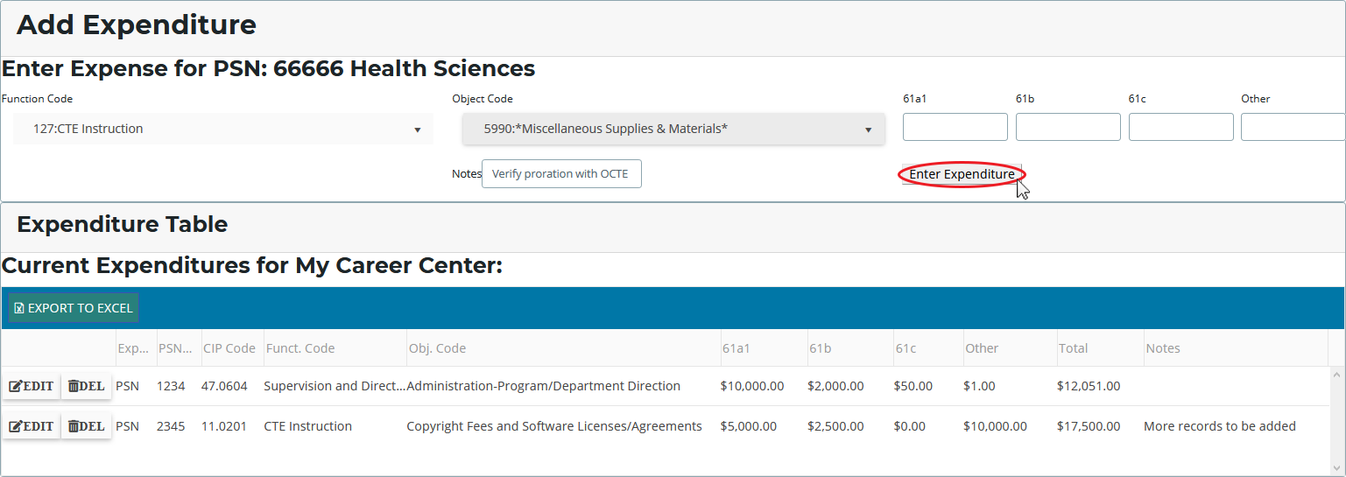
Entering Expenditure Records
Click Data Entry  Expenditures  Expenditure Entry.
Select your district and building.
Click a [$] button to enter program expenditures.
Select a function and object code, then enter the dollars that were applied to the program from each of the four funding sources.

Slide 15
The 4-Step Process
Collect expenditure information from appropriate personnel.
Enter expenditure records.
Enter Manually
Create distribution tables (optional).
Import
Run expenditures validation.
Submit your final Expenditures Report.

Slide 16
Distribution Tables
Allow you to spread the cost of an expenditure across multiple PSNs.
Examples:
Distributing a single teacher’s salary across multiple programs.
“Bundling” travel time to apply to many PSNs.
Claiming maintenance costs for several classrooms.
Distribution Table: “Travel”
PSN | Amount to Report
07703 | 25%
14038 | 25%
17755 | 50%
Click Data Entry  Expenditures  Distribution Tables.
Select your district and building.
Click check boxes to include programs, then name and save the table.
CTEIS will divide expenditure entries in the table across the PSNs included, weighted based on your chosen settings.

Slide 17
The 4-Step Process
Collect expenditure information from appropriate personnel.
Enter expenditure records.
Enter Manually
Create distribution tables (optional).
Import
Run expenditures validation.
Submit your final Expenditures Report.

Slide 18
The 4-Step Process
Collect expenditure information from appropriate personnel.
Enter expenditure records.
Enter Manually
Create distribution tables (optional).
Import
Run expenditures validation.
Submit your final Expenditures Report.

Slide 19
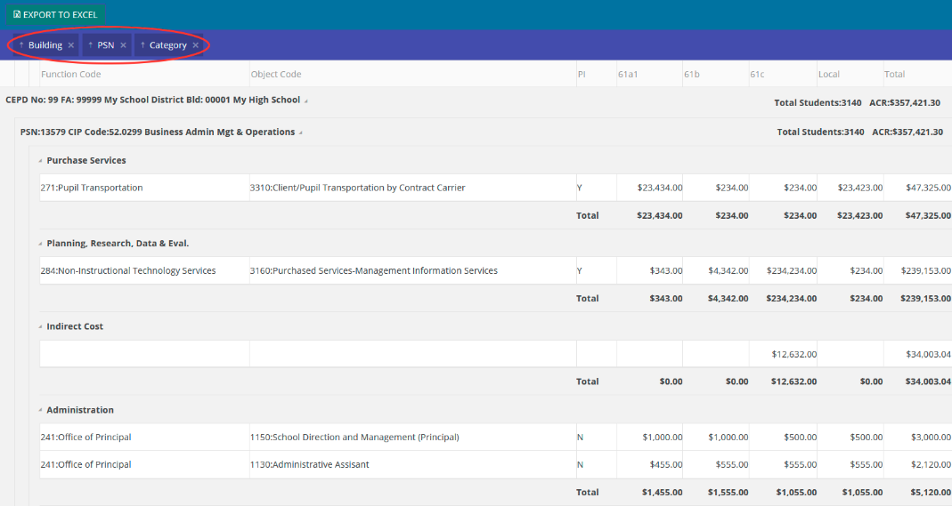
Run Expenditure Validation
Click Data Entry  Expenditures  Expenditure Review.
Select your district.
Click a [VALIDATE] button to review expenditure entries.
Filter your view by:
Removing labels from the header (Building, PSN, Category).
Dragging additional labels to the header row.

Slide 20
Completing Your Report
After all errors are cleared:
The Complete button becomes active.
When a building is marked complete, the system attempts to E-mail your Fiscal Agency Authorized Official.
Follow up by contacting your FA personally.
Export your report to an Excel file.

Slide 21
Submitting Your Report
Reports submitted at the building level are subject to a series of reviews:
Building Level → Fiscal Agent →
CEPD Administrator → OCTE
Directions for Fiscal Agent and CEPD Administrator submissions are on the CTEIS Knowledge Base:
support.cteis.com/Data-Entry/Expenditures

Slide 22
Support
Technical Help
I pushed a button, and nothing happened!
Why am I getting this error message?
PTD Help Desk
cteis.help@PTDtechnology.com
(800) 203-0614 or (517) 333-9363
Ext. 128
Policy Help
Where do I find my info?
How do I report a credit?
Joan Church
ChurchJ@michigan.gov
(517) 335-0360
OCTE Website: http://www.michigan.gov/octe

Slide 23
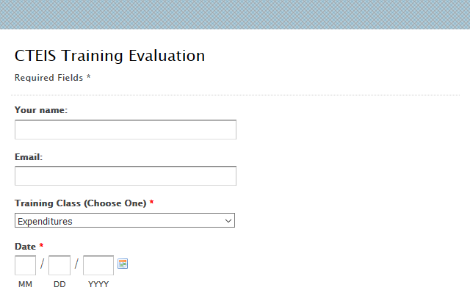
Questions?
Thank you!
Don’t forget to fill out our Training Evaluation Form at
support.cteis.com/Training/ Registration-General-Info

