Slide 1
Fall Data Entry for the Spring Enrollment Report
Presented by
PTD Technology
3001 Coolidge Road Suite 403
East Lansing, MI 48823

Slide 2
Agenda
OCTE data Updates
Valerie Milton, Ph. D. (nee Felder)
Project Monitor – CTEIS
MDE - OCTE
Fall Enrollment Data Entry
Doug Wiesner, Ph. D.
Project Manager for CTEIS
PTD Technology

Slide 3
OCTE Data Updates

Slide 4
Agenda
Fall Enrollment Data Entry
Preparation – Instructional Design
Courses
Staff
Complete Fall Data Course Review
Students
Enrollments
Grades
Report Reviews
Spring Tasks Preview

Slide 5
Preparation Proper Instructional Design Maximize Student Progress

Slide 6
Geographic/Building
Terminology
Programming
CEPD – Career Education Planning District
Career Cluster
CIP Code - Classification of Instructional Programming Code
FA - Fiscal Agency
PSN – Program Serial Number (CIP Code in a building)
OA – Operating Agency (Operating Agency)
Program Type * Regular
* EMC – Early Middle College
OB – Operating Building (Sending Building)
CSC – Course Section Code
SubSection
Segments/Competencies

Slide 7
Student Progress
Important for Funding
Important for CPIs
PIV – Perkins IV Legislation
Segments : concentrator >8
PV – Perkins V Legislation
Competencies : concentrator 2 PCCs

Slide 8
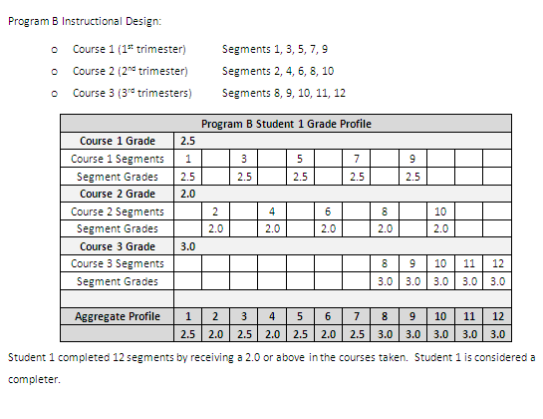
Segment Profiles
Courses deliver sets of segments to students.
Students receive a course grade.
If the course grade is a 2.0 or higher, the student receives credit for each segment within the course.
If multiple courses offer the same segment, the highest grade determines whether the segment is included or not.
Forms available on Support.cteis.com

Slide 9
Perkins V
Cosmotology (12.0400)
Health Sciences (51.0000)
Education General (13.0000)
Business (52.0299)
Automotive Technology (47.0604)
Electrical (46.0301)
Construction (46.0000)

Slide 10
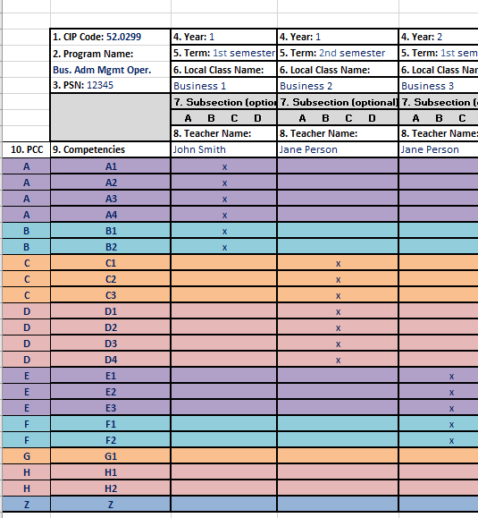
CIP Codes Reporting by Competencies and PCCs
Example of Instructional Design Form
Forms available on support.cteis.com

Slide 11
What Is The Report Process?
Several types of data need to be entered into CTEIS:
Course data (using a provided instructional design form).
Verify class details, instructors, and segments.
Student data.
Enrollment data.
Grades.
After entering your information:
Verify and correct data as required.
Review student segment profiles to ensure your students can become completers.

Slide 12
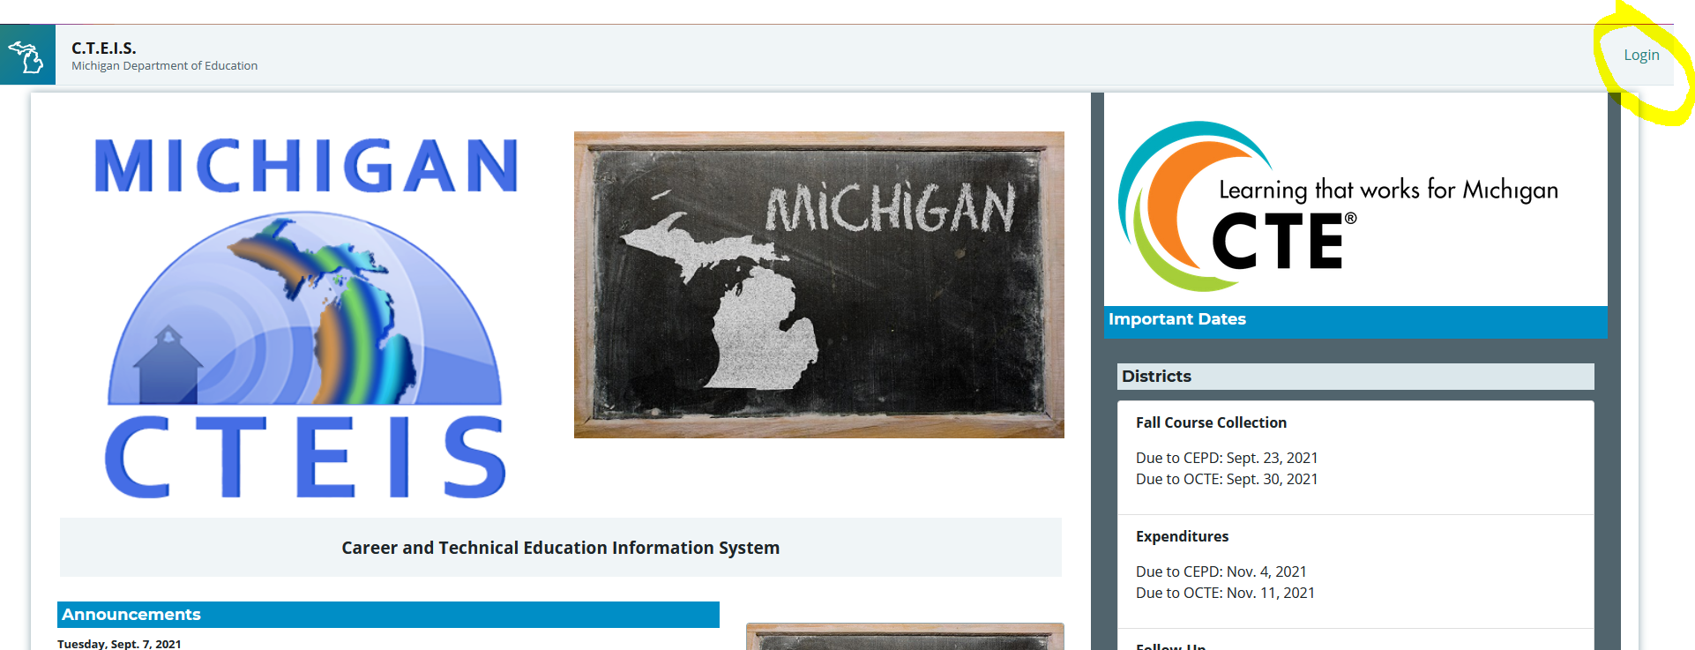
Login to CTEIS.com
Get a MEIS account
Soon will need a MiLogin account
Get your FA to put you in
Get to work

Slide 13
Manage Courses and Staff Fall Course Collection DEMO

Slide 14
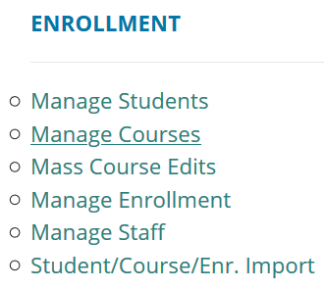
Manage Courses
Use an instructional design form when entering courses.
Building reporters are never responsible for determining class details or segment information.
Look for the Data Entry link.
Click on Manage Courses.
Here you may:
Add a new course section
Edit individual course sections
Copy course information
Contracted Programs OA-OB 36000 00000

Slide 15
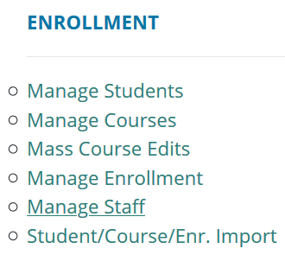
Manage Staff
The Manage Courses screen also allows you to input staff members and link them to your courses.
Use the Course Section Staff List panel at the bottom of the screen.
Go to Data Entry, then Manage Staff.
Here you may:
View staff records.
Add new staff records.
Edit pre-existing staff records.

Slide 16
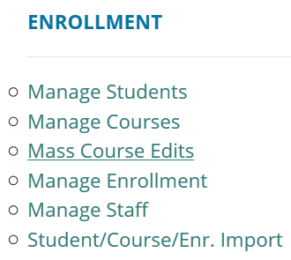
Mass Course Edits
Mass Course Edits allow you to update multiple records simultaneously.
Go to Data Entry, then Mass Course Edits.
The fields you may mass edit include:
Beginning and ending dates
Semester
Virtual delivery mode
High school credits earned
College credits earned
You may also Mass Deactivate courses using this feature.

Slide 17
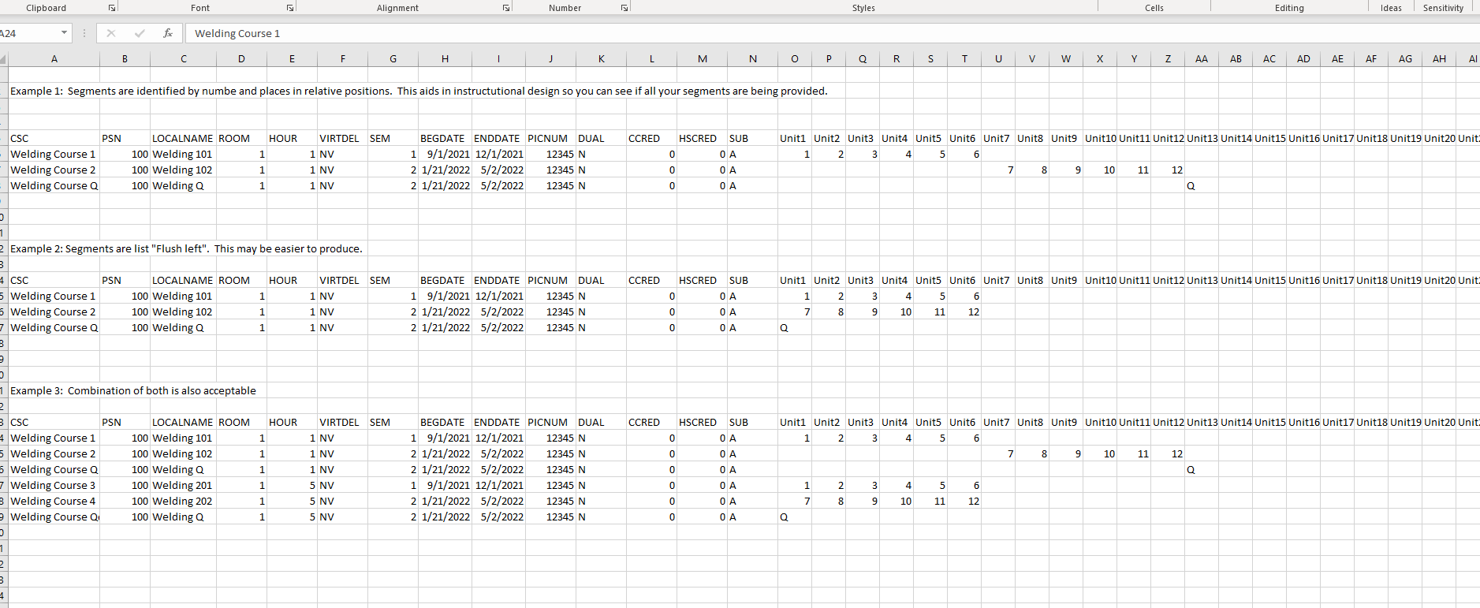
Course Imports

Slide 18
Manage Students

Slide 19
Manage Students
It is extremely important that this information is entered correctly as it is used to:
Update MSDS supplemental data.
Allow Follow-Up reporters to contact students.
Go to Data Entry, then Manage Students.
From this screen, you may:
Add new student records
Edit / Review pre-existing student records
View student enrollment history and segment profiles

Slide 20
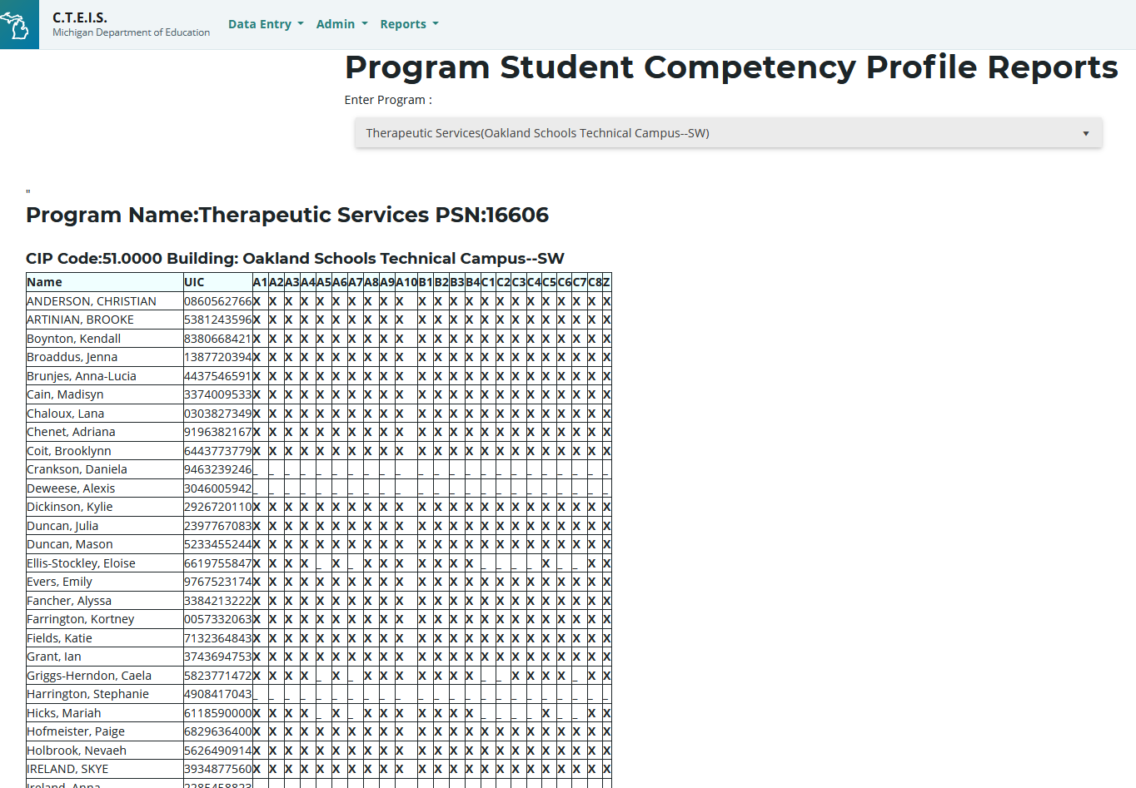

Slide 21
Manage Enrollments

Slide 22
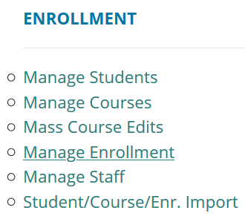
Manage Enrollment
CTEIS offers a variety of tools to help you manage your student enrollments.
Go to Data Entry, then Manage Enrollment.
Here you may take a variety of actions:
Enroll students in courses
Edit student enrollment information
Copy / transfer enrolled students from one class to another
Print a class list
Input student grades
Check the segments students are enrolled in

Slide 23
Enter Grades
If your school uses a grade point system rather than letter codes, use the conversion chart within the instructional guide.
Go to Data Entry, then Manage Students.
Locate and select the student you wish to enter grades for.
Locate the “Current Enrollment” panel.
Select a grade from the drop-down menu.
OR
Go to Data Entry, then Manage Enrollment.
Select the course and student you wish to enter grades for.
Click “Edit;” enter a grade within the “LetterGrade” column and click “Update.”

Slide 24
Enrollment Imports Support.CTEIS.Com

Slide 25
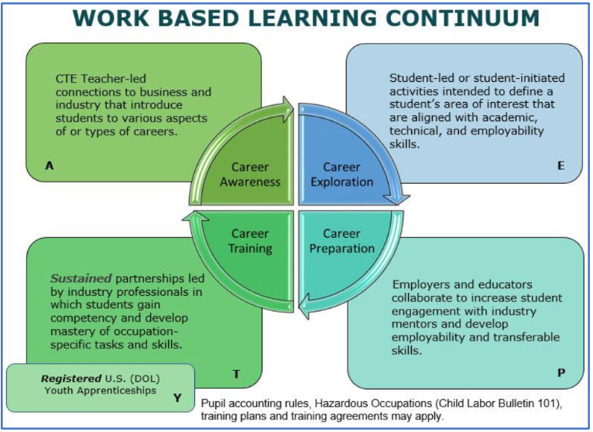
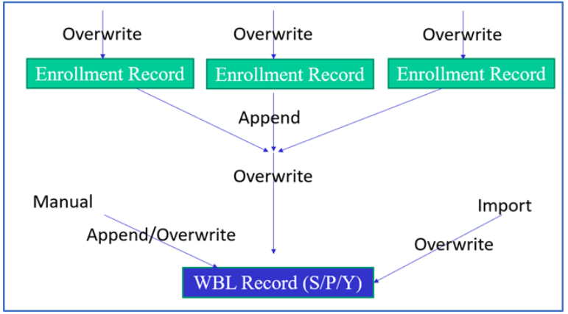
Work Based Learning
By Course
By Program
Manual
Imports

Slide 26
Manage Credentials required for 5S1 CPI
By Program
Manual
Import

Slide 27
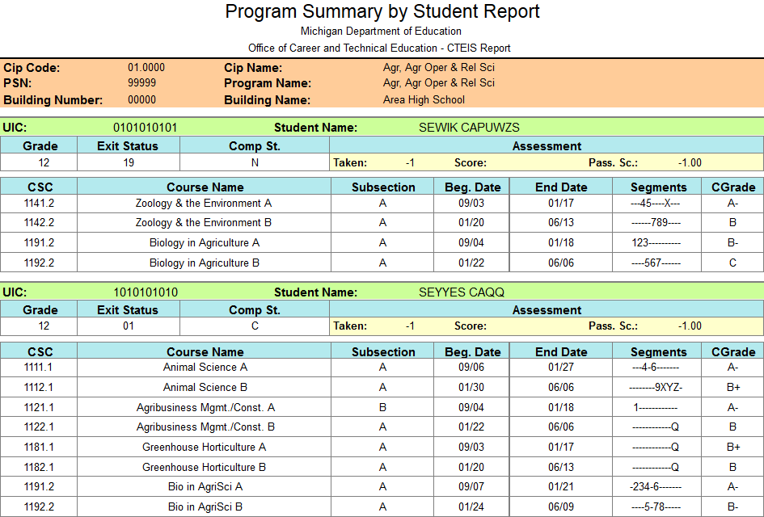
Review Building Reports
Program Enrollment History Report
Displays the historical information of all students enrolled within a selected program.
Includes segment profiles and assessment scores.
Go to Reports ➔ Building Reports ➔ Program/Student Reports.
Use these reports to verify that:
Your students have been enrolled into the correct courses for the current year.
Your courses offer the 12 segments required for your students to become completers.

Slide 28
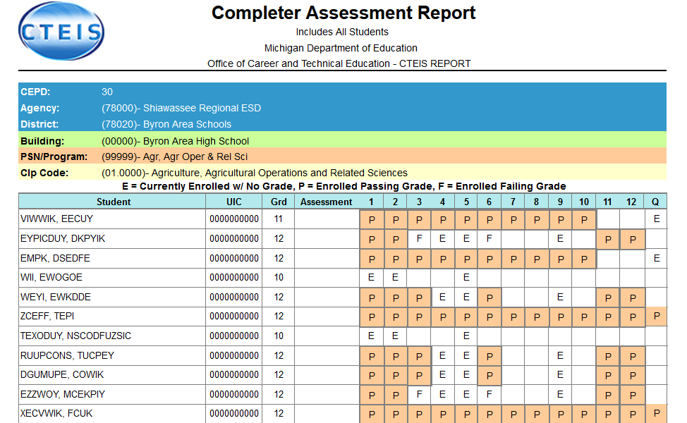
Validate Enrollment Data
Run validation early and frequently to alert yourself to student data issues that may take time to resolve, and to also gain access to helpful reports.
Go to Data Entry ➔ Enrollment Completion.
Indicate the year you wish to run the validation for.
Click the Validate link to the left of the building name.
Review all warnings.
Correct all errors.
Print your summary enrollment reports.

Slide 29
Fall Reminders!
Fall Course Collection – Due Sept. 23
Only Courses and Staff
Not Students, Enrollments, Segments, Competencies, WBL, Creds, etc
All CTE Student enrolled – Due May 15th
Enrolled once
Not Grades, segments, competencies, WBL, Creds.
Final Enrollment Collection – Due June 16th
Everything Due! Courses, Students, Enrollments, WBL , Creds

Slide 30
What Is CTE Enrollment Collection?
The annual report required by OCTE that verifies your student, teacher, and class enrollment data.
Important uses of your data:
Determines next year’s funding allocations.
Allows the state adhere to federal reporting requirements.
Updates student exit and completer status – segment verification is extremely important!

Slide 31
Support
Technical Help
I pushed a button and nothing happened!
Why am I getting this error message?
PTD Help Desk
cteis.help@PTDtechnology.com
(800) 203-0614 or (517) 333-9363
Ext. 128
Policy Help
Where do I find my info?
How do I report a credit?
Joan Church
ChurchJ@michigan.gov
(517) 335-0360
OCTE Website: http://www.michigan.gov/octe

Slide 32
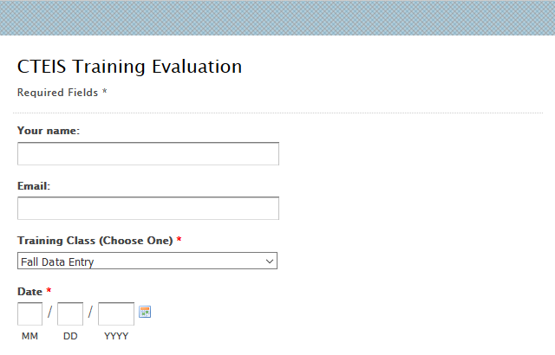
Questions?
Thank you!
Don’t forget to fill out our Training Evaluation Form at
support.cteis.com

Slide 33
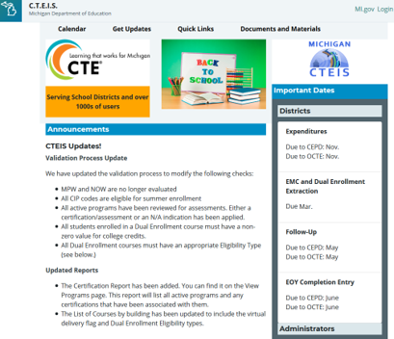
CTEIS Updates
Join the CTEIS Listserv for continual updates: e-mail MartinezJ9@michigan.gov
Fall Data Entry: building reporters must enter courses and instructors into CTEIS by October 30, 2020.
The New Programs Application is moving to the Grant Electronic Management System (GEMS).
The due date is still TBD.
New Work-Based Learning guides and training schedules will be published in the near future.

