Slide 1
CTEIS Updates
Douglas Wiesner, Ph. D. PTD Technology

Slide 2
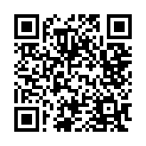
Doug Wiesner, Ph.D.
PTD Technology
This slide deck will be available on SUPPORT.CTEIS.com shortly

Slide 3
What’s New with CTEIS?
Manage Credentials
List of all State-Approved CTE Credentials
Updated Manage Credentials entry page
Review of Credential reports
Manage Work-Based Learning
Review of WBL reports
2023 CTEIS Updates
Enrollments
Manage Enrollments Update
Minimal Import Update
Mange Students Update
Migrant Students
CEPD Admin Building Enrollment Report
Class List Report
Expenditures
X0207 Report
Upcoming Dates

Slide 4
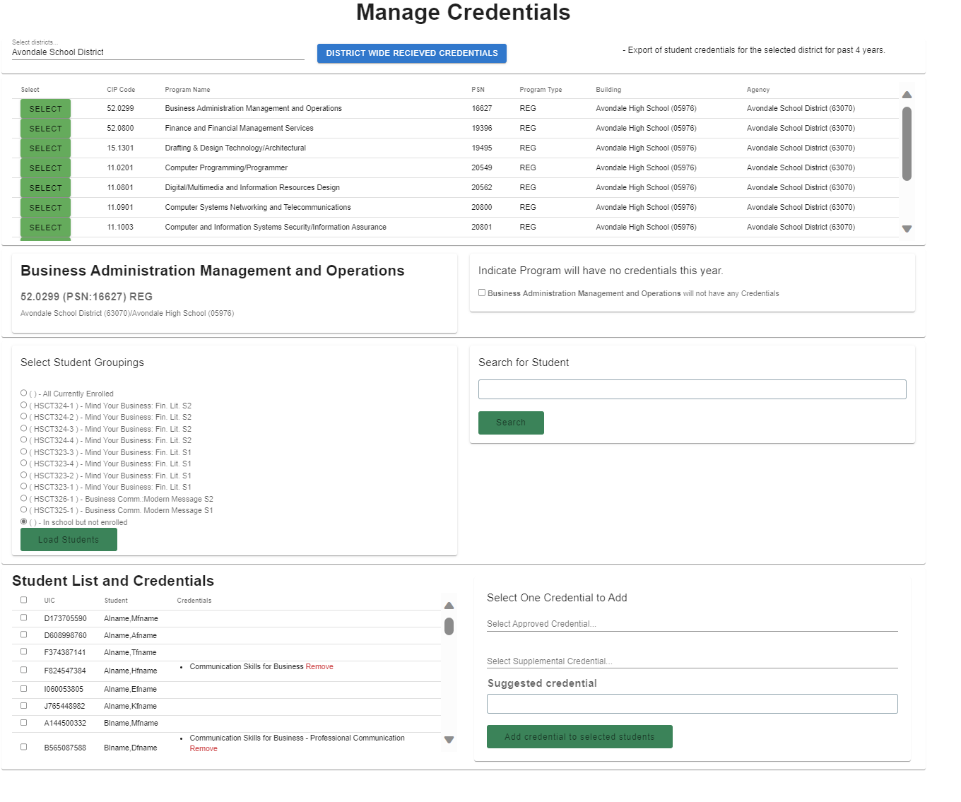
Updated Manage Credentials
Manage Credentials
Update District Manage Credentials
Faster, easier to use
Works generally the exact same

Slide 5
Credential Reporting
Manage Credentials
Public Reports – (Reports.CTEIS.com)
List of All State-Approved CTE Credentials -NEW
Approved CTE Credentials Offered by Districts
Michigan School CTE Program Credentials
District CTEIS Reports (CTEIS.com)
Credentials by PSN

Slide 6
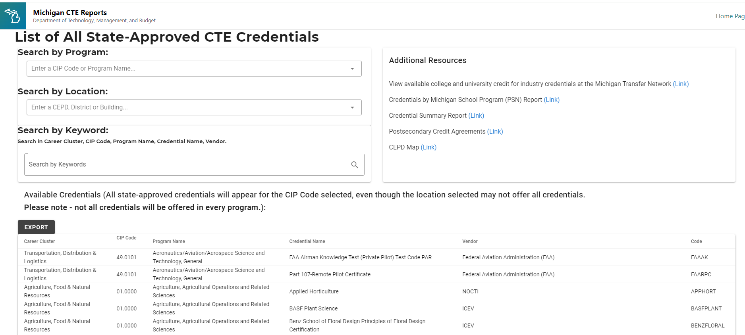
List of All State-Approved CTE Credentials
Manage Credentials
List of all available credentials
Searchable, sortable, exportable
Lists all Credential Codes required for imports

Slide 7
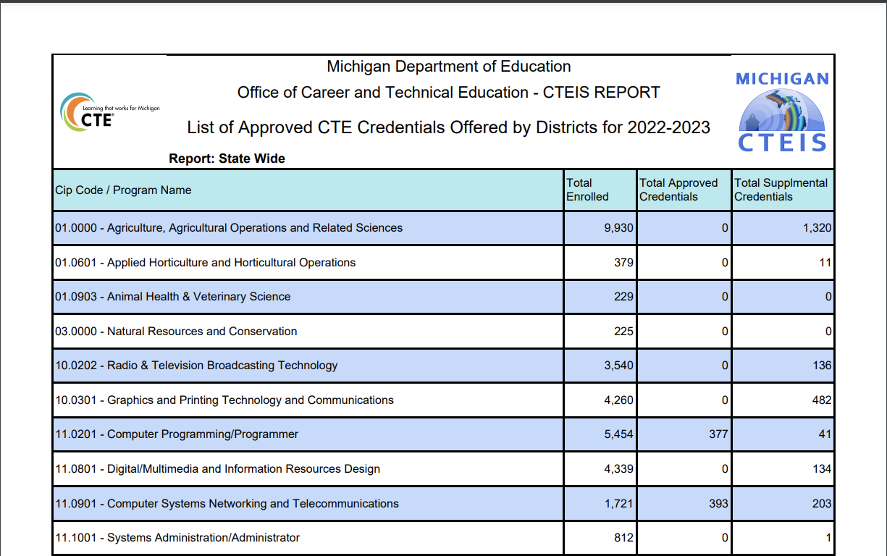
Approved CTE Credentials Offered by Districts
Manage Credentials
REPORTS.CTEIS.COM
Available
Statewide
CEPD
FA
Building
CIP Code
Fed Cluster
Region
List of all Approved, Supplemental and Suggested Credentials by Entity.

Slide 8
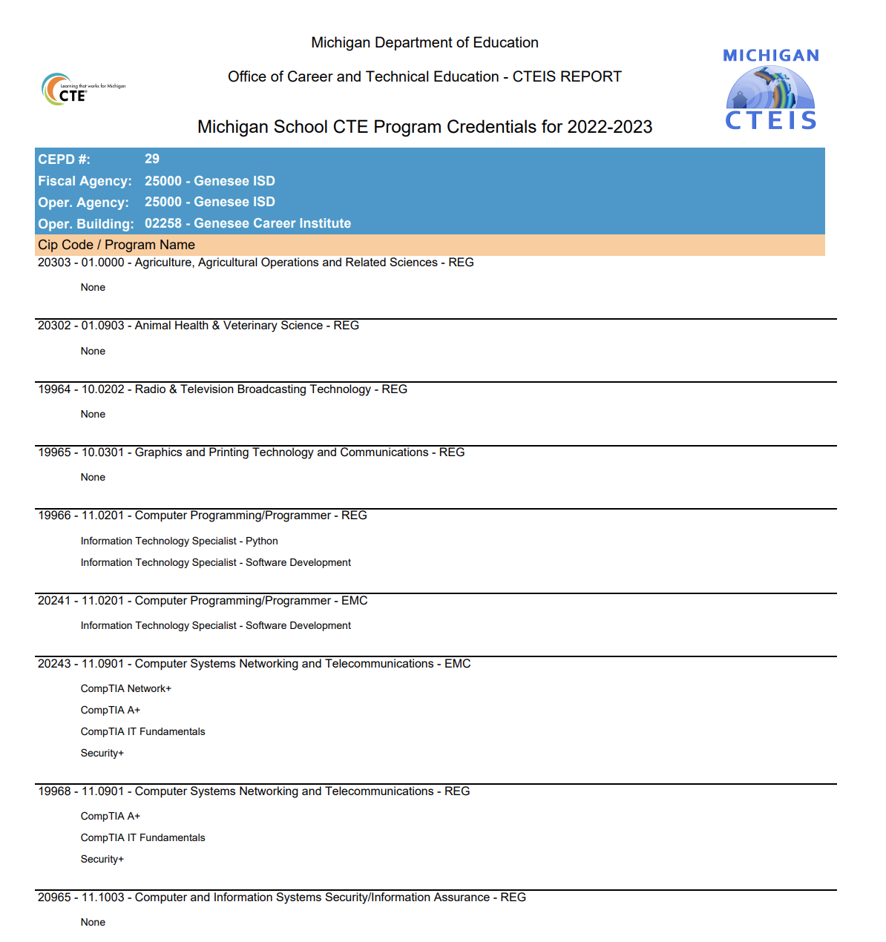
Michigan School CTE Program Credentials
Manage Credentials
REPORTS.CTEIS.COM
Available by
Fiscal Agency
Building
CIP Code
Fed Cluster
By Year
List all programs in a building and what credentials have been granted.

Slide 9
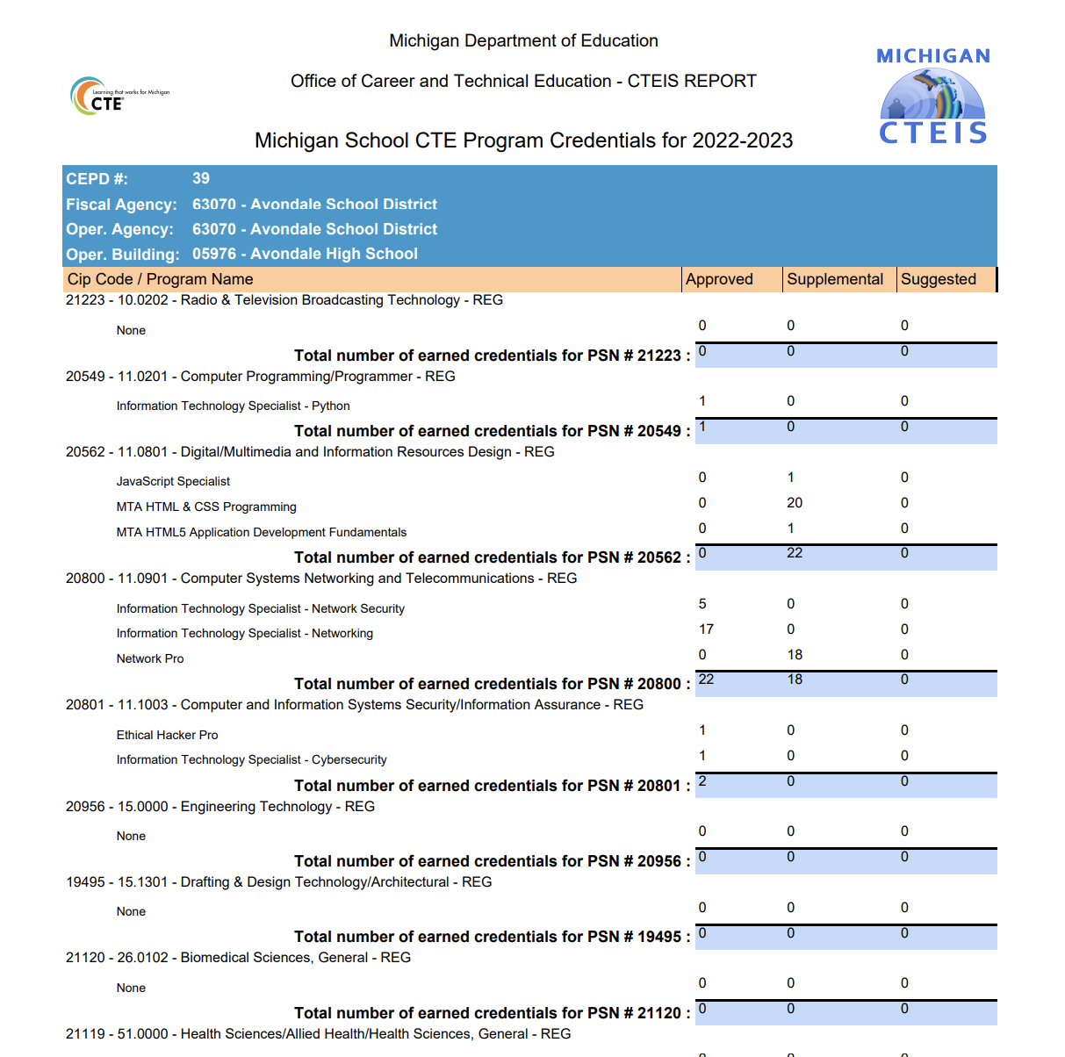
Credentials by PSN
Manage Credentials
CTEIS.COM (requires login)
Available for your assigned buildings
By Building, lists
Credentials provided in the selected year
Counts of
Approved
Supplemental
Suggested

Slide 10
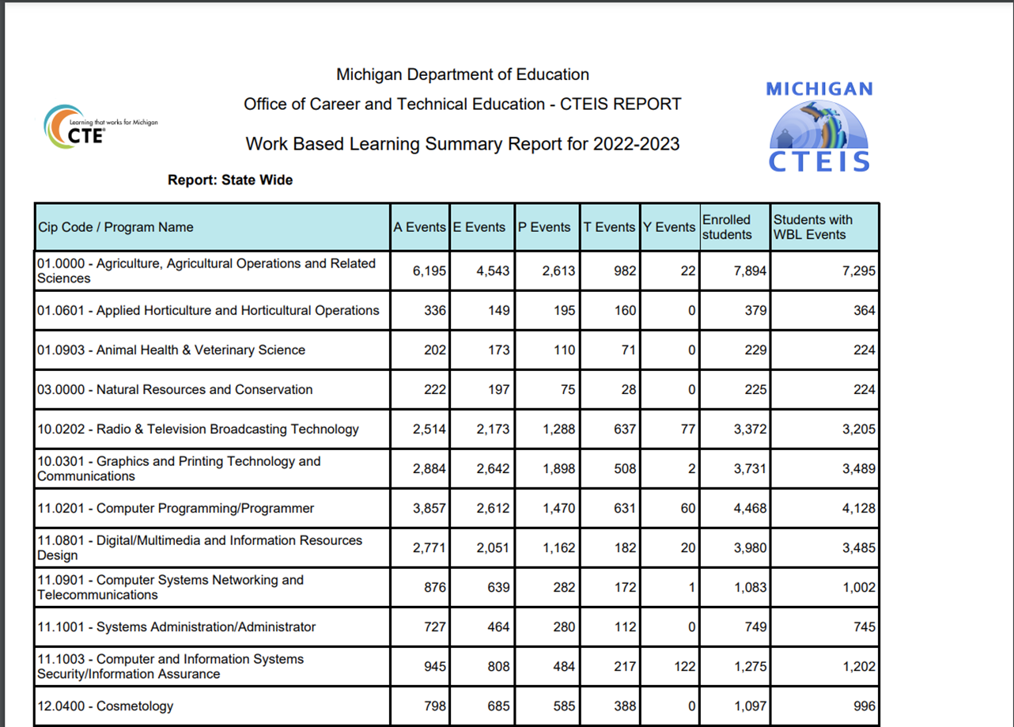
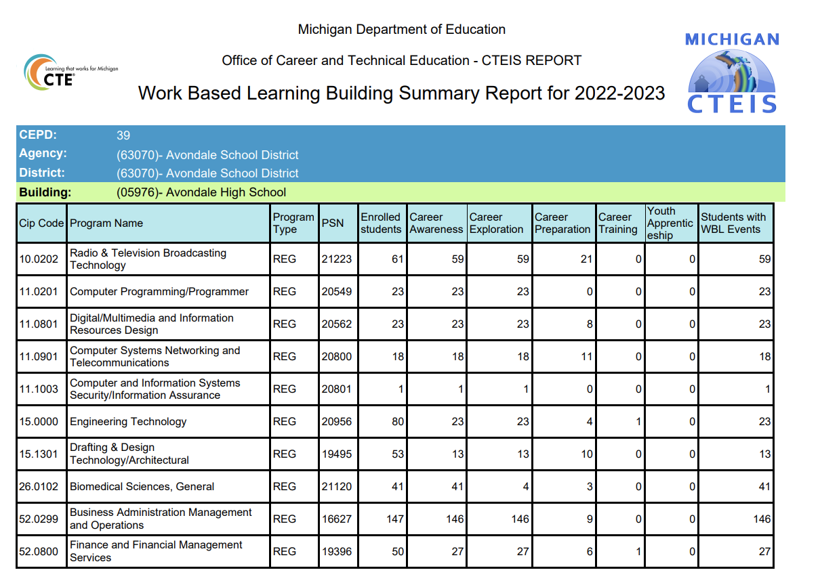
Work based learning Reports review
Work Based Learning
REPORTS.CTEIS.COM
Work Based Learning Summary Report
District CTEIS.com
Work Based Learning Summary by Building

Slide 11
2023 CTEIS Updates
Enrollments
Manage Enrollments Update
Minimal Import Update
Mange Students Update
Migrant Students
CEPD Admin Building Enrollment Report
Class List Report
Expenditures
X0207 Report

Slide 12
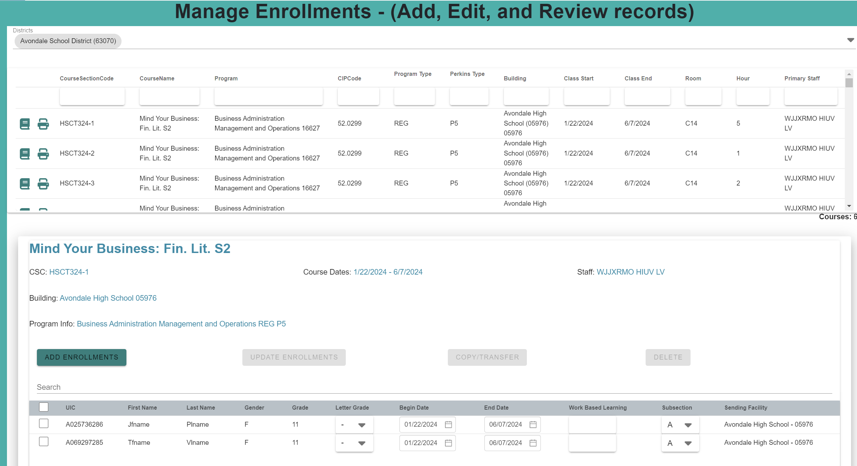
2023 CTEIS Updates
Manage Enrollments
Manage Enrollments Update
Faster
Easier to use
Inline edits of enrollments

Slide 13
2023 CTEIS Updates
Manage Enrollments
Minimal Import Update
Requires
UIC
Last name
Course Section Code
Building
Grade/WBL
Requires
Enrollment record already exists
Student
Course
Enrollment

Slide 14
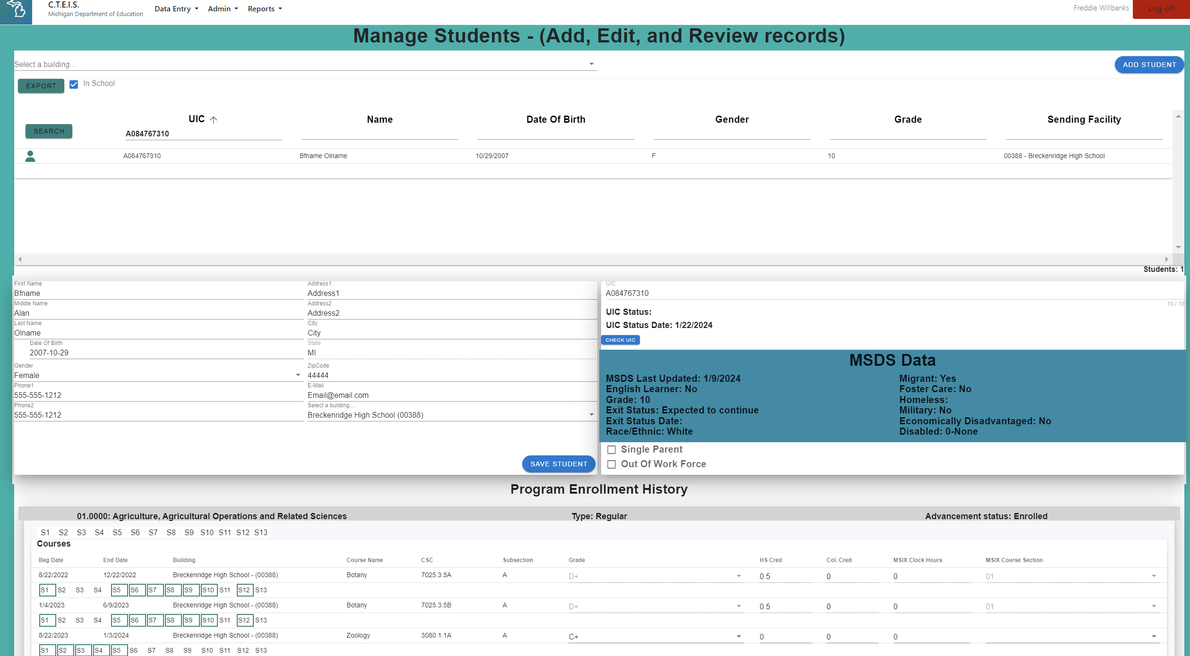
2023 CTEIS Updates
Manage Enrollments
Mange Students Update
Migrant Students

Slide 15
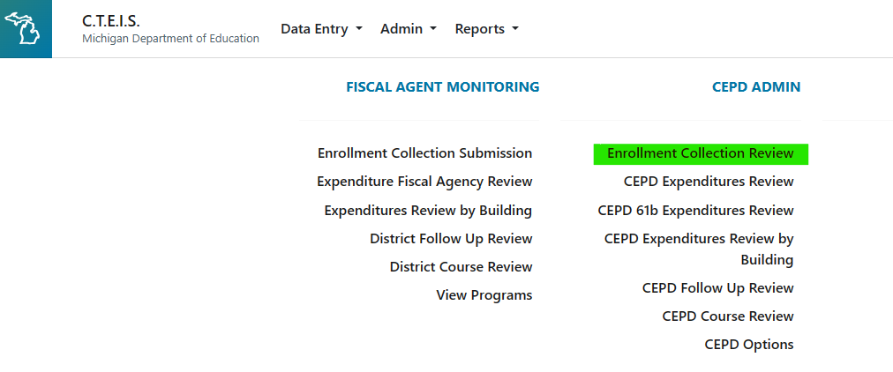
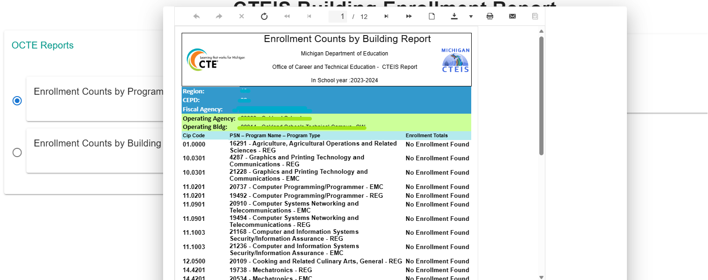
2023 CTEIS Updates
Manage Enrollments
CEPD Admins
Enrollment Collection Review
Building Enrollment Reports

Slide 16
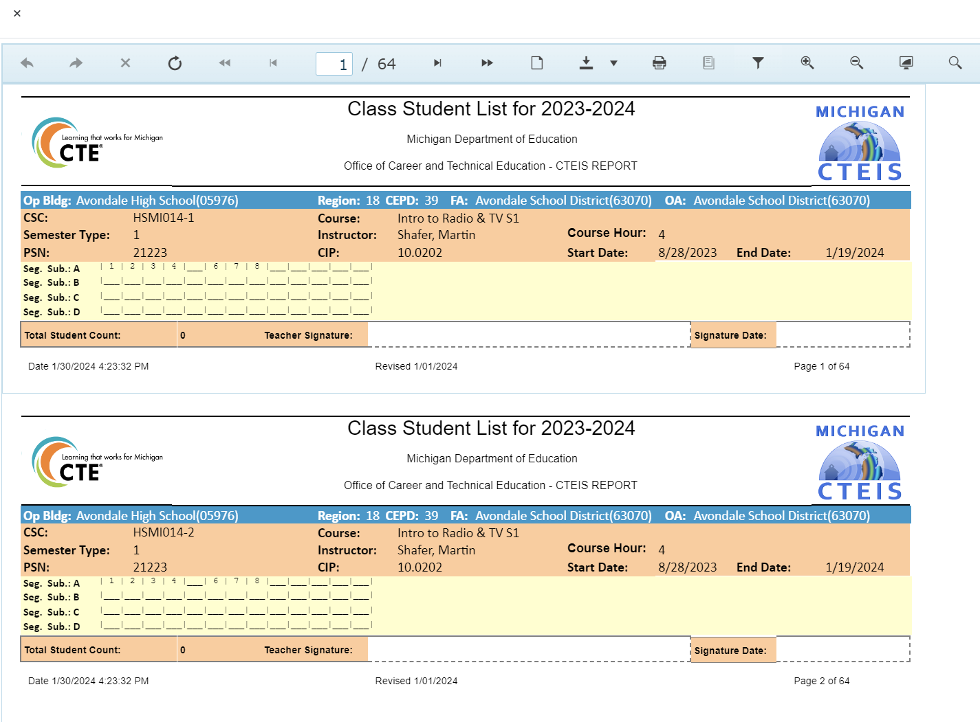
2023 CTEIS Updates
Manage Enrollments
Class List Report
Shows segs/comps for empty classes

Slide 17
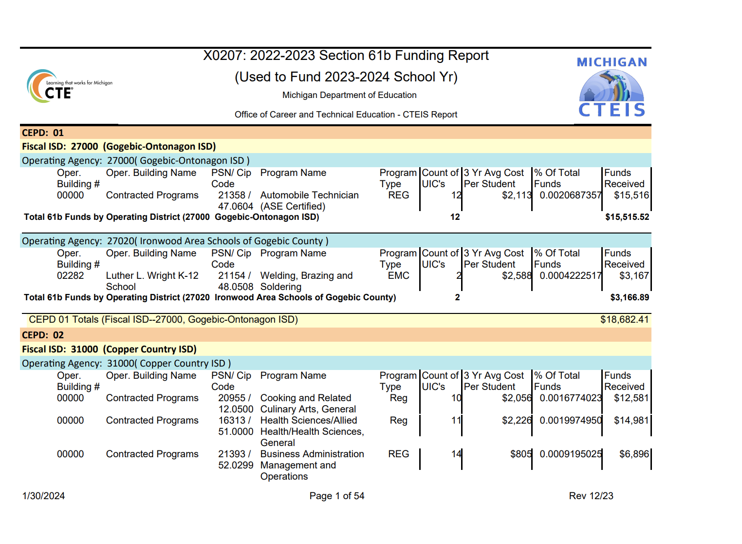
2023 CTEIS Updates
Manage Expenditures
Expenditures
X0207 Report

Slide 18
Upcoming dates
EOY Completion Entry
EMC and Dual Enrollment Extraction
Work Based Learning
Due to CEPD: Jun. 13, 2024 Due to OCTE: Jun. 20, 2024
Credentials
Preliminary reporting Due to CEPD: Jun. 13, 2024 Preliminary reporting Due to OCTE: Jun. 20, 2024 Final reporting Due to OCTE: Aug. 31, 2024
Administrators
CEPD Options
Due June 6, 2024
Count Days
Fall: Oct. 4, 2023 Spring: Feb. 14, 2024
***May 12, 2024 - Final student enrollment deadline (must include correct UICs)

Slide 19
Upcoming training
Spring Enrollment Training
CTEIS Spring Tasks:
March 12, 2024
March 14, 2024
Completing CTEIS Enrollment Collection:
April 16, 2024
April 18, 2024
April 23, 2024
April 25,
April 30, 2024
May 2, 2024
Completing Spring Enrollment e-Workshop:
June 11, 2024
Fiscal Agent Training
May 29, 2024
CEPD Administrator Training
May 29, 2024

Slide 20
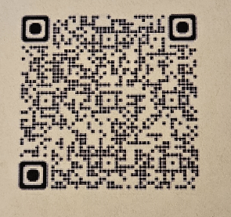
Thank You! Questions?
Doug Wiesner, Ph.D.
PTD Technology
Doug.Wiesner@PTDTechnology.com
CTEIS.Help@PTDTechnology.com
Check out our Knowledge Base at http://support.cteis.com
This slide deck will be available on SUPPORT.CTEIS.com shortly
SCECHS

