Slide 1

Follow-up Training 2025

Slide 2
Perkins Core Performance Indicator 3S1: Post program Placement
CTE concentrators who exited high school and responded to the follow-up survey during the preceding reporting year
Were in placement 2nd quarter after exiting high school:
Postsecondary Education/Advanced Training
Employment
Military Service
National and Community Service Programs
Peace Corps Volunteers
Notes:
One of the main purposes of follow-up survey is to collect Perkins Core Performance Indicator - Post program Placement (3S1)
The survey data are also used in a variety of ways at both the Federal and State levels. At the Federal level, OCTAE uses the data to show the impact of CTE funding to the U.S. Legislature. This may, in turn, affect future federal funding. Similarly, MDE uses the data to show the impact of State funding of CTE programs to the Michigan legislature. Additional data uses by the State include:
Ranking programs to allocate Added Cost funds.
Program review consideration of the data in answering questions such as “Are CTE concentrators finding jobs or continuing their training in a related field?”

Slide 3
Follow-Up Survey Data
Year | Total eligible concentrators | Response Rate | Proxy Rate | Self-Survey | Placement | Employed | Continuing Education
2022-23 | 37,407 | 86.3% | 11.8% | 23.6% | 95.4% | 88.2% | 69.9%
2023-24 | 37,940 | 87.3% | 9.8% | 27.9% | 95.1% | 87.7% | 70.4%
2024-25 | 40,260 | 86.1% | 8.1% | 30.4% | 95.4% | 87.7% | 71.7%

Slide 4
Importance of Response Rate
High quality for the CPI post-program placement indicator—3S1.
Perkins V requirement – all concentrators
Verification study results
Notes:
We need to understand the importance of response rate to the quality of the CPI post-program placement indicator—3S1.
Perkins V requires states to report post-program placement for all CTE Concentrators. This means the Follow-Up Survey is not based on a sample but must cover the entire population. We are expected to make a good-faith effort to survey every qualified concentrator. The quality and usefulness of the data depend on accurate reporting of each concentrator’s status, and achieving a strong response rate is essential to ensure the results accurately represent all concentrators statewide.
Previous verification studies have shown that districts with low response rates often under-report their placement rates because they failed to reach students who were employed during regular weekdays.

Slide 5
Response Rate
Requirement
A low response rate negatively affects buildings, CEPDs and the state by reducing the accuracy of the placement information used to evaluate CTE programs.
Institutions with response rates below 80% may be found to be in noncompliance during a TRAC onsite monitoring visit.
Districts with one or more buildings with response rates below 50% will be required to send a representative to a technical assistance workshop before next Follow-Up survey.

Slide 6
Tips
Phone Survey
When to call.
Use Answering Machine.
Caller ID.
Multiple ways
Relatives
Social media
Interviewer Best Practices:
Starting time
Tracking form
Stay connected
Admin Best Practices:
High bar
Tiered stipend
Weekly update
No proxy at first
Notes:
Additional recommendations for increasing response rates can be found on page 9 of the Protocol Manual.
Best practices for the CTEIS Follow-Up Survey, summarized from high-performing regions, are available on the CTEIS Knowledge Base webpage

Slide 7
Proxy Rate Requirement
Buildings with proxy rates higher than 20% will be required to attend a follow-up training before the next follow up survey. This will be included in the follow-up protocol manual and these buildings will receive a letter indicating the requirement.
The proxy rate requirement for the TRAC risk analysis and compliance finding will be reduced.
  For TRAC risk analysis: Regions that have 1 or more buildings with a proxy rate greater than 20% will be flagged on the risk analysis.
  For TRAC onsite visit: Regions that have a regional proxy rate greater than 20% will receive a finding of noncompliance and be required to prepare a compliance plan.

Slide 8
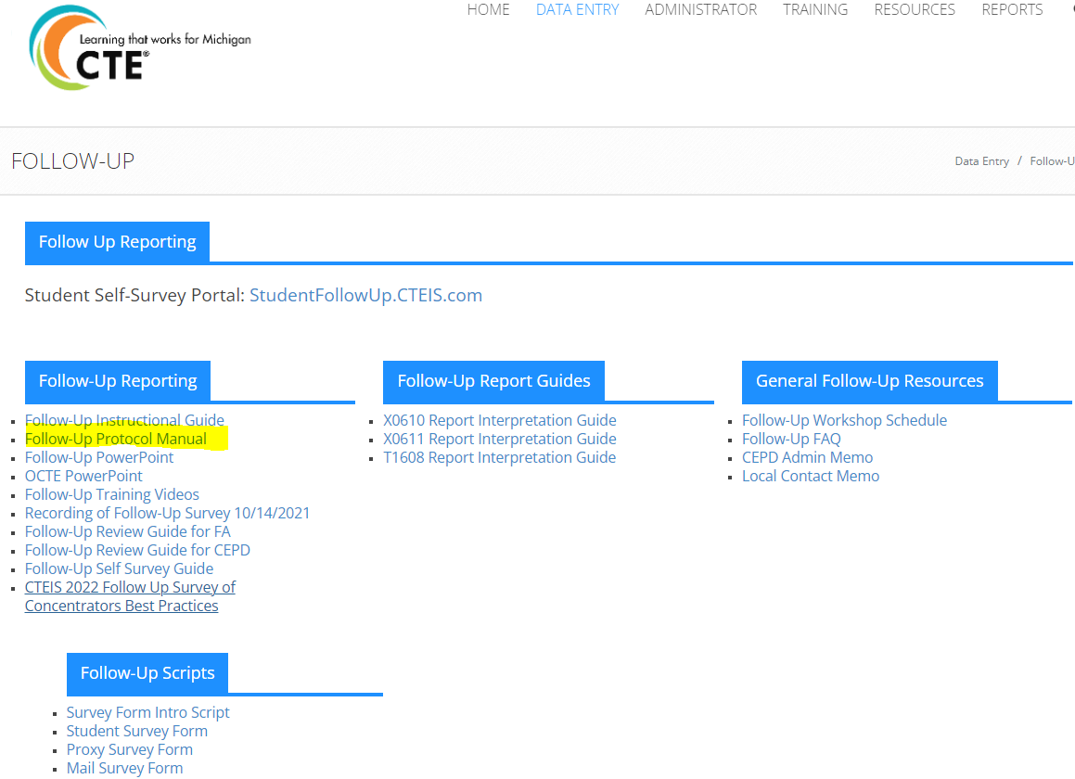
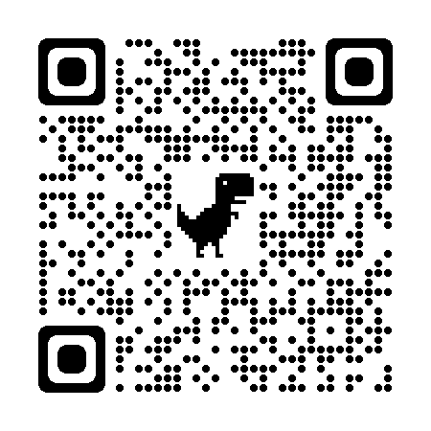
Use of Follow-up Protocol Manual
Response Rate & Proxy Rate requirement
Guidance on how to get survey items one by one
Background and purpose of follow-up survey

Slide 9
Follow up Reporting
Timeline
Follow-up list available and survey window open:
October 2025
Deadline for reporting data:
January 15, 2026, due to CEPD
January 22, 2026, due to OCTE
Follow-up reports available:
April 2026

Slide 10
Contact Information
Yincheng Ye
YeY@michigan.gov
517-281-7229

