Slide 1
Follow-up Training 2026

Slide 2
Perkins Core Performance Indicator 3S1: Post program Placement
CTE concentrators who exited high school and responded to the follow-up survey during the preceding reporting year
Were in placement 2nd quarter after exiting high school:
Postsecondary Education/Advanced Training
Employment
Military Service
National and Community Service Programs
Peace Corps Volunteers
Notes:
The Follow-Up Survey was designed to meet reporting needs at the Federal, State, and local levels. It aims to track all CTE concentrators’ placement in the 2nd quarter after they exit high school. The purpose of follow-up survey includes:
To collect placement data for Core Performance Indicators (CPIs)-3S1 placement rate for Perkins V.
Placement data for use in ranking programs for State Added Cost funding purposes.
Local educational agencies with data to use for program improvement, or for local placement coordinators to use in assisting students who are not currently placed.

Slide 3
Follow-Up Survey Data
Year | Total eligible concentrators | Response Rate | Proxy Rate | Self-Survey | Placement | Employed | Continuing Education
2023-24 | 37,940 | 87.3% | 9.8% | 27.9% | 95.1% | 87.7% | 70.4%
2024-25 | 40,260 | 86.1% | 8.1% | 30.4% | 95.4% | 87.7% | 71.7%
2025-26 | 43,386 | 86.3% | 7.8% | 32.8% | 95.5% | 88.2% | 72.0%

Slide 4
NEW: Follow up Self Survey Tool - Teacher
Student component accessible with student PIN
Teacher component accessible with teacher PIN
• Each teacher PIN is linked to a specific student

Slide 5
Importance of Response Rate
High quality for the CPI post-program placement indicator—3S1.
Perkins V requirement – all concentrators
Verification study results
Notes:
We need to understand the importance of response rate to the quality of the CPI post-program placement indicator—3S1.
Perkins V requires states to report post-program placement for all CTE Concentrators. This means the Follow-Up Survey is not based on a sample but must cover the entire population. We are expected to make a good-faith effort to survey every qualified concentrator. The quality and usefulness of the data depend on accurate reporting of each concentrator’s status, and achieving a strong response rate is essential to ensure the results accurately represent all concentrators statewide.
Previous verification studies have shown that districts with low response rates often under-report their placement rates because they failed to reach students who were employed during regular weekdays.

Slide 6
Response Rate
Requirement
A low response rate negatively affects buildings, CEPDs and the state by reducing the accuracy of the placement information used to evaluate CTE programs.
Institutions with response rates below 80% may be found to be in noncompliance during a TRAC onsite monitoring visit.
Districts with one or more buildings with response rates below 50% will be required to send a representative to a technical assistance workshop before next Follow-Up survey.

Slide 7
Tips
Phone Survey
When to call.
Use Answering Machine.
Caller ID.
Multiple ways
Relatives
Social media
Interviewer Best Practices:
Starting time
Tracking form
Stay connected
Admin Best Practices:
High bar
Tiered stipend
Weekly update
No proxy at first
Notes:
Additional recommendations for increasing response rates can be found on page 9 of the Protocol Manual.
Best practices for the CTEIS Follow-Up Survey, summarized from high-performing regions, are available on the CTEIS Knowledge Base webpage

Slide 8
Proxy Rate Requirement
Buildings with proxy rates higher than 20% will be required to attend a follow-up training before the next follow up survey. This will be included in the follow-up protocol manual and these buildings will receive a letter indicating the requirement.
The proxy rate requirement for the TRAC risk analysis and compliance finding will be reduced.
  For TRAC risk analysis: Regions that have 1 or more buildings with a proxy rate greater than 20% will be flagged on the risk analysis.
  For TRAC onsite visit: Regions that have a regional proxy rate greater than 20% will receive a finding of noncompliance and be required to prepare a compliance plan.

Slide 9
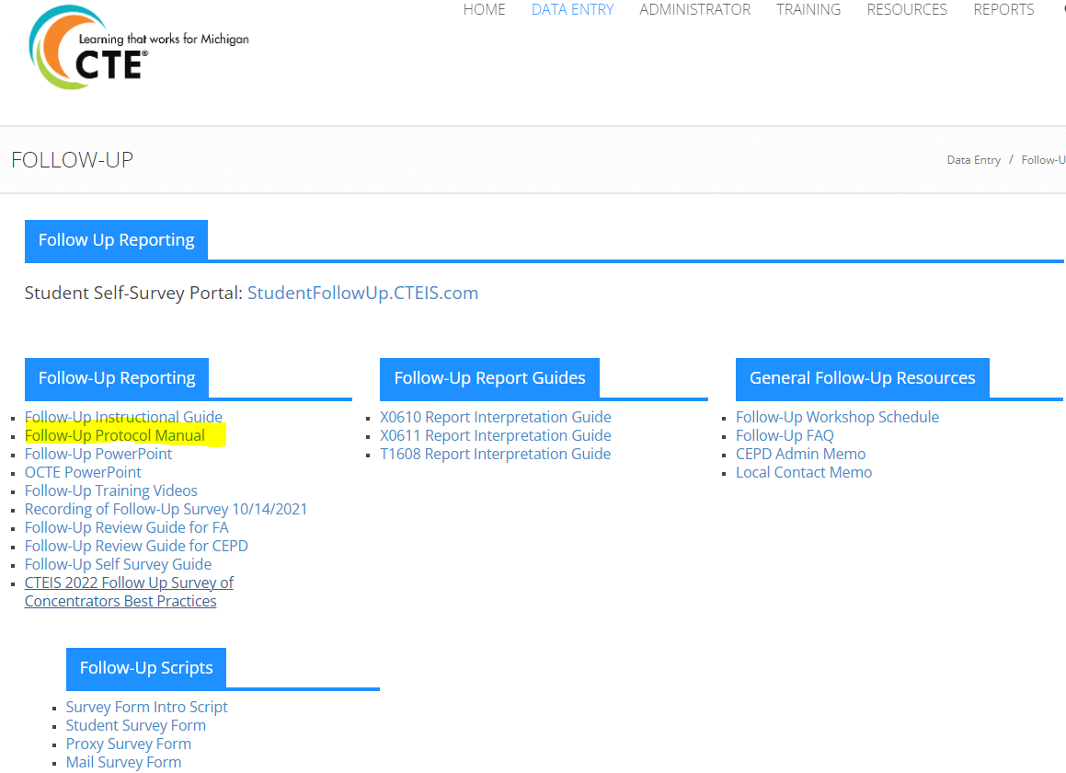
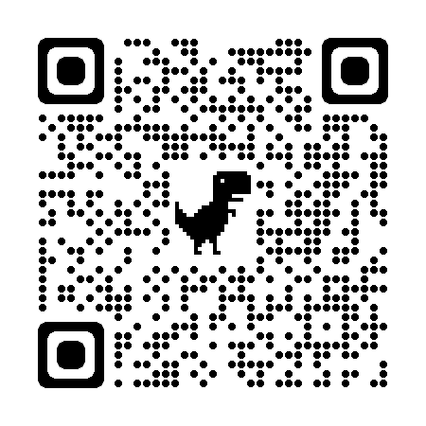
Use of Follow-up Protocol Manual
Response Rate & Proxy Rate requirement
Guidance on how to get survey items one by one
Background and purpose of follow-up survey

Slide 10
Follow up Reporting
Timeline
Follow-up list available and survey window open:
October 2026
Deadline for reporting data:
January 14, 2027, due to CEPD
January 21, 2027, due to OCTE
Follow-up reports available:
April 2027

Slide 11
Contact Information
Yincheng Ye
YeY@michigan.gov
517-281-7229

